Slide 1
On Board Data Handling Subsystem Design
DFH SATELLITE CO., LTD
February.2019

Slide 2
Outline
OBDH Specification
OBDH Composition
Telecommand Management
Telemetry Management
Communication on-board
Time Management
Time-tagged Command
Time-tagged data block
Relative time-tagged telecommand
Safe Mode
Thermal Control

Slide 3
Objectives
After finishing the learning of programme Participants will/ can :
Understand the function of OBDH
The composition of OBDH
Be clear about the procedure of Telecommand and Telemetry Management

Slide 4
Acronym list
OBDH：On Board Data Handling
OBC：On Board Computer
TCU：Thermal Control Unit
PCU: Power Control Unit
BMU: Battery Management Unit
DTS: Data Transmission Subsystem
AOCC: Attitude and Orbit Control Computer
PPS: Pulse per Second
GS: Ground Station
TTC: Time-tagged Command
Related to subsystem

Slide 5
PART 1: OBDH Specification
OBDH functions
OBDH (onboard data handling subsystem) is kernel of satellite’s electronic system and responsible for satellite onboard working and information management. OBDH main Functions are as follows:
To receive Telecommands and data blocks from ground stations and distribute them to the satellite subsystems.
To collect the satellite telemetry data and send them to ground stations.
To manage the on-board time.

Slide 6
PART 1: OBDH Specification
4. To provide the capability of receive and distribute the on-board commands and time-tagged commands.
5. To provide the capability of thermal control.
6. To store and restore the important data of AOCS.
7. To communicate with other subsystem via CAN bus.
8. To monitor the important parameters of satellite and manage the safe mode (FDIR) of satellite.

Slide 7
PART 1: OBDH Specification
Main Parameters of OBDH
Type | Item | Parameter
Mass | Power of OBDH | ≤ 480g
Power | Power of OBDH | ≤ 3W
Reliability | Reliability of OBDH | ≥0.95

Slide 8
PART 1: OBDH Specification
Type | Item | Parameter
Telemetry | Data Rate | 4096bps

Slide 9
PART 1: OBDH Specification
Type | Item | Parameter
Telecommand | Number of Direct OC Command (from Responder) | 8
 | Number of OC Indirect Command (from OBC , Responder and PCU) | 40
 | Data Rate | 2000bps
 | Storage Capacity of time tagged Telecommand | 1000

Slide 10
PART 1: OBDH Specification
Type | Item | Parameter
Timing System | On-board Timing reference | UTC
 | Time Precision | ≤5ms
Thermal control | Channels of heaters | 24
 | Channels of temperature measure | 24
Analog Channel | Number of analog measuring channel | 8

Slide 11
PART 1: OBDH Specification
Type | Item | Parameter
CAN Bus | Bus type | CAN
 | Baund rate | 500kpbs
 | BUS utilization | ≤30%

Slide 12
PART 1: OBDH Specification
Operation Mode
Normal mode implements all the functions as required, which is default operation mode of OBDH subsystem.
OBDH subsystem monitors the required parameters and manages the safe mode of the satellite. OBDH is mainly responsible for system level FDIR to make sure the safety of satellite system.

Slide 13
PART 1: OBDH Specification
Operation Mode
Some abnormal can be dealt with by resetting some devices, or switching some devices to the redundant module, when the abnormal disappear, the OBDH will return to normal mode automatically.
If the abnormal shall be dealt with by turning off the payload, and all the TTCs of the payload will be cleared, it shall be handled by the GS to resume the payload task.

Slide 14
PART 2: OBDH Composition
OBDH subsystem consists of On Board Computer (OBC) and Thermal Control Unit (TCU), which receives TC data from, and sends TM data to transponders of T&TC subsystem, communicates with other subsystem via CAN bus.

Slide 15
PART 2: OBDH Composition
The subsystem topology is shown as following.

Slide 16
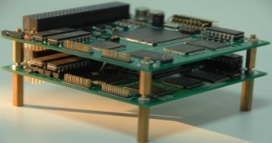
PART 2: OBDH Composition
OBC Photo
TCU Photo

Slide 17
PART 2: OBDH Composition-OBC
OBC is the kernel of OBDH subsystem, witch takes charge of CAN bus communication, TM collection and format, indirect TC receive, decode and execution, monitoring satellite status and communicating with other units.

Slide 18
PART 2: OBDH Composition-OBC
OBC’s main functions include:
TM Management: Collect telemetry data from all subsystems, after encapsulating the telemetry in packet, and then in transfer frame, OBC sends the TM frame to Transponder.
TC Management: Receive and decode the indirect TC or data block from TU, OBC execute indirect TC/ data block if it belongs to OBC, or distribute it via CAN bus, if the indirect TC/ data block belongs to other device.

Slide 19
PART 2: OBDH Composition-OBC
3) Time management: Generate the platform time, set and adjust the platform time when needed, broadcast the platform time to other subsystem via CAN bus.
4) Bus network on-board management: Perform communication management of CAN bus.
5) AOCS data management: Collect and store the AOCS important data, and return the data to AOCS when needed.

Slide 20
PART 2: OBDH Composition-OBC
6) Payload task management: The payload tasks are encapsulated in the form of TTC/TTD/RTTC, and stored in OBC, the OBC execute the payload tasks and control the payload to work at the predefined time.
7) Monitor the satellite-launcher separation signal, and execute predefined command sequence after separation.

Slide 21
PART 2: OBDH Composition-OBC
8) Safe mode Control: OBDH subsystem monitors the important parameters of satellite and manages the safe mode of satellite. OBDH monitors the critical TMs (such as the status of power supply system and AOCS). When the critical TMs become abnormal, OBDH sends safe command sequence such as closing the payload to make sure the satellite energy safety and enter the safe mode of satellite.

Slide 22
PART 2: OBDH Composition-OBC
To collect analog telemetry of USB transponders and send telemetry (including the telemetry of transponder and TU itself) to OBC via CAN bus.
To receive and execute the indirect TC from OBC via CAN bus.
To receive and encrypt TM data from OBC, send it to USB transponder.
To monitor the satellite-launcher separation signal, and execute predefined command.

Slide 23
PART 2: OBDH Composition-OBC
Thermal Control Unit(TCU) is designed to measure the temperature and implement the control method by activating heaters. The TCU receives indirect TC from OBC, and sends TM and temperature parameters to OBC by the CAN bus.

Slide 24
PART 2: OBDH Composition-OBC
TCU’s functions include:
1) To supply 32 temperature and analog measuring channels.
2) To supply 24 heaters, and each heater can supply 5W maximally.
3) Receive indirect TC from OBC, and send status TM and temperature TM to OBC by CAN bus.

Slide 25
PART 2: OBDH Composition-OBC
Summary
1. OBDH (onboard data handling subsystem) is kernel of satellite’s electronic system and responsible for satellite onboard working and information management.
2. OBDH subsystem includes onboard computer (OBC) and thermal control unit (TCU).

Slide 26
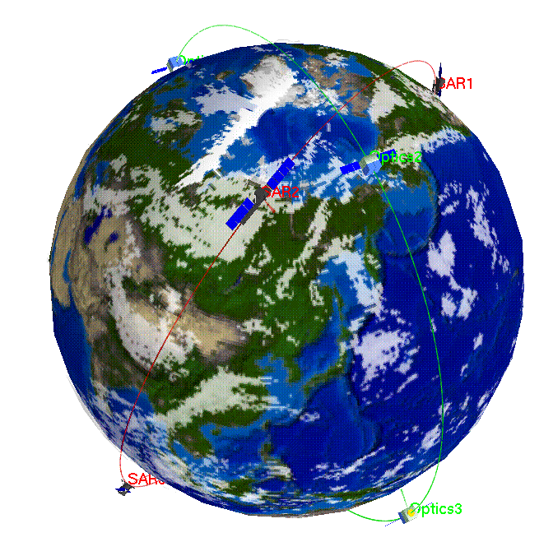

PART 3: Telecommand Management
Satellite
Telecommand
Ground Users
Data rate: 2000 bps

Slide 27
PART 3: Telecommand Management
Telecommand(TC) is the only way to control the satellite from GS. In ETRSS-1 OBDH subsystem, the function of TC is fulfilled by Transponder and OBC. From the aspect of the way of execution, TC can be classified as direct TC and data block.
TYPES | DESCRIPTIONS
Direct TC | Received and decoded by Transponder, and Transponder will execute the TC in the way of OC, 8 commands(8 wires).
Indirect OC command | generated by OBC, transponder A/B or PCU, each Direct command uses one line, good reliability
Indirect data command | Indirect data command: generated by OBC, transmited by CAN bus, reliable
Indirect data block | upload to any equipement connected to CAN bus, transmited by CAN bus, reliable

Slide 28
PART 3: Telecommand Management
Telecommand Information Flow
TC data shall be uploaded from GS, received by USB transponder, After demodulation, and analysis, direct TC will be executed immediately, all the indirect TC/data block will transmitted to OBC.
OBC shall handle them and then transmit them to different units through CAN bus.

Slide 29
PART 3: Telecommand Management
Direct TC
OC
Ground

Slide 30
PART 3: Telecommand Management
Indirect TC
Ground
CAN BUS

Slide 31
PART 3: Telecommand Management
Satellite address synchronization word: 7718H
Mode word:
5AH | The length of executing code is 128bits(16bytes)
69H | The length of executing code is 512bits(64bytes)
99H | The length of executing code is 1024bits(128bytes)
A5H | The length of executing code is 2048bits(256bytes)

Slide 32
PART 3: Telecommand Management
TC transfer frame format
Transfer Frame Primary Header (40 bits, 5bytes) |  |  |  |  |  |  |  | Transfer Frame Data Field | Frame Error Control Field
Transfer Frame Version Number | RSVD. SPARE | RSVD. SPARE | RSVD. SPARE | Spacecraft ID | Virtual Channel ID | Frame Length | Frame Sequence Number
2 bits | 1 bit | 1 bit | 2 bits | 10 bits | 6 bits | 10 bits | 8 bits |  | 16 bits
00 | 1 | 0 | 00 | 00 0000 00 00 |  | 0x0F, 0X3F, 0X7F, 0XFF | 00 | 9,57,121,249bytes | XOR

Slide 33
PART 3: Telecommand Management
Summary
1. Telecommand is used to control satellite by GS.
2. Telecommand includes direct command and indirect command/data block.
There are four types of data block with the length of 16, 64, 128 and 256 bytes.
Indirect TC is a special data block with the length of 16 bytes, and the execution code is 4 bytes.

Slide 34
PART 4: Telemetry Management
Satellite
Telemetry
Ground Users
Data rate: 4096 bps

Slide 35
PART 4: Telemetry Management
Telemetry(TM) is the only way for the GS to monitor the state of satellite. In ETRSS-1, telemetry function is fulfilled by OBC, CAN bus network, and the subcomputers in each subsystem.
The subcomputer collects the telemetry of each subsystem, then the TM shall be collected through CAN bus and assembled into frames under protocol by OBC, and then is sent to Transponder.

Slide 36
PART 4: Telemetry Management
Fast telemetry packet
Collection Period 1s/2s/4s/8s
Slow telemetry packet
Collection Period 16s/32s

Slide 37
PART 4: Telemetry Management
TM Name | Packet header I D(Hex) | Packet length (bytes) | Data length (bytes) | Collection Period (second) | Delay Pack ID(Hex) | Status
OBC fast | 10H | 42 | 43 | 1 | 410H | online
OBC fixed format TM | 30H | 23 | 24 |  | 430H | no packet TM
OBC Slow | 20H | 28 | 29 | 32 | 420H | online
OBC RTTTC counter | 70H | 63 | 64 | 32 | 470H | offline
OBC TTTC code | 90H | 55 | 56 | 32 | 490H | online
OBC bus counter | A0H | 69 | 70 | 32 | 4A0H | online
OBC uplink data block | B0H | 16、64、128、256 | 16、64、128、256 | Single | 4B0H | offline
OBC storage downlink | C0H | 67 | 68 | Single | 4C0H | offline
OBC data block | E0H | 241 | 242 | Single | 4E0H | online
OBC RTTTC code | F0H | 16、64、128、256 | 16、64、128、256 | Single | 4F0H | offline
OBC 1wire temparature | 50H | 39 | 40 | 32 | 450H | offline
OBC RTTTC exec status | 40H | 40 | 41 | 32 | 440H | offline
Transponder A fast | 22H | 15 | 16 | 1 | 422H | online
Transponder B fast | 25H | 15 | 16 | 1 | 425H | online
PCU fast | 23H | 11 | 12 | 2 | 423H | online
PCU slow | 43H | 25 | 26 | 16 | 443H | online
AOCC fast | 24H | 127 | 128 | 1 | 424H | online
AOCC slow | 44H | 127 | 128 | 32 | 444H | online
BCU fast | 28H | 13 | 14 | 4 | 428H | online
TCU temprature slow | 47H | 107 | 108 | 32 | 447H | online
TCU status slow | 67H | 107 | 108 | 32 | 467H | online
TCU important count | 52H | 18 | 19 | 8 | 452H | online
DTS Fast | 2BH | 7 | 8 | 2 | 42BH | online
DTS Slow | 4BH | 15 | 16 | 16 | 44BH | online
GPS fast TM | 2AH | 19 | 20 | 2 | 42AH | online
GPS status slow | 4AH | 125 | 126 | 32 | 44AH | online
GPS orbit slow | 6AH | 86 | 87 | 32 | 46AH | online
Camera Fast | 2CH | 34 | 35 | 2 | 42CH | online

Slide 38
PART 4: Telemetry Management
What’s in telemetry packet ?
Time, orbit, attitude
Healthy status. Self-test flags
Communication counters. Upload counters, CAN data bus error counters
Temperature

Slide 39
PART 4: Telemetry Management
TM transfer frame format(According to CCSDS Space Packet Protocol)
0 | 1 | 2 | 3 | 4 | 5 | 6 | 7 | 8 | … | … | 13 | 14 | 15 | 16 | 17 | … | 127
EB | 90 | AA | AA | AA | AA | ## | ## | ## | … | … | ## | ## | ## | ## | ## | … | ##
Attached Syn Marker |  | Reserved |  |  |  | Transfer Frame Primary Header |  | Fixed Format Telemetry |  |  |  | Master Channel Frame count | Virtual Channel Frame count | First Packet Header Pointer | Transfer Frame Data Field
2 |  | 4 |  |  |  | 2 |  | 6 |  |  |  | 1 | 1 | 1 | 111

Slide 40
PART 4: Telemetry Management
What is CCSDS ?
The Consultative Committee for Space Data Systems
Founded in 1982 by ESA/NASA/CNES/DLR/JAXA etc.
Defines Recommendations and standards for spacecraft.

Slide 41
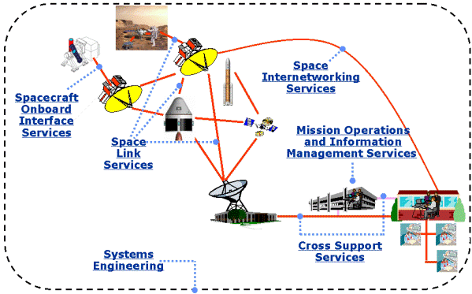
Documents by CCSDS Area:

Slide 42
Space Link Services Area
CCSDS has developed four protocols for the Data Link Protocol Sublayer of the Data Link Layer:
TM Space Data Link Protocol
TC Space Data Link Protocol
AOS Space Data Link
Proximity-1 Space Link Protocol—Data Link Layer .

Slide 43
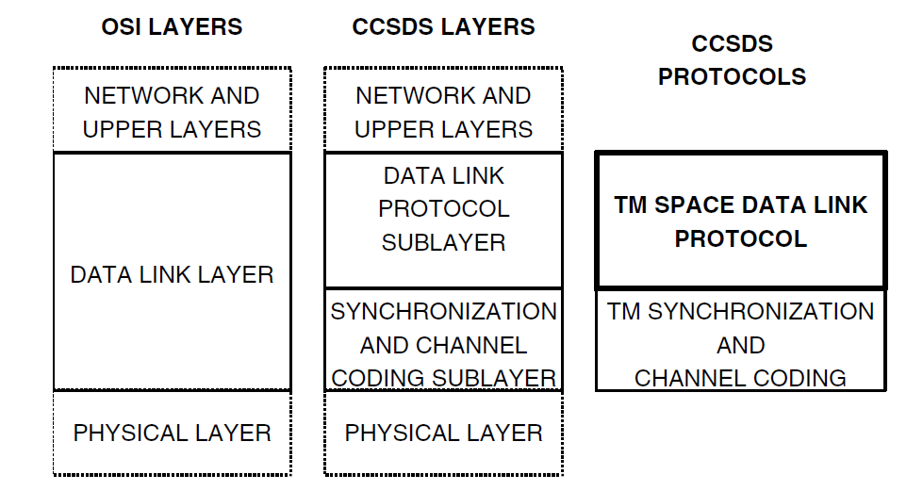
TM SPACE DATA LINK PROTOCOL
The TM Space Data Link Protocol corresponds to the Logical Link Sublayer, and provides functions of transferring various data using a fixed-length protocol data unit called the Transfer Frame.

Slide 44
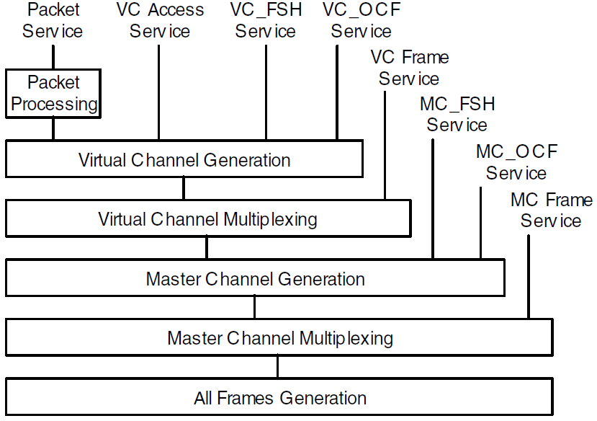
TM SPACE DATA LINK PROTOCOL
Channel Tree of the TM Space Data Link Protocol

Slide 45
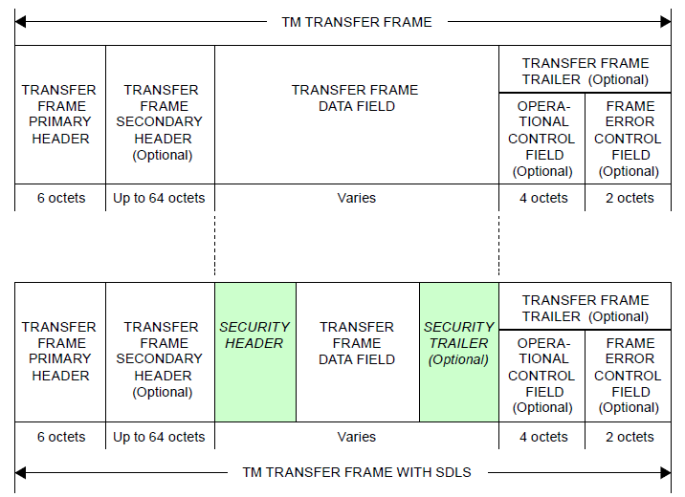
TM SPACE DATA LINK PROTOCOL

Slide 46
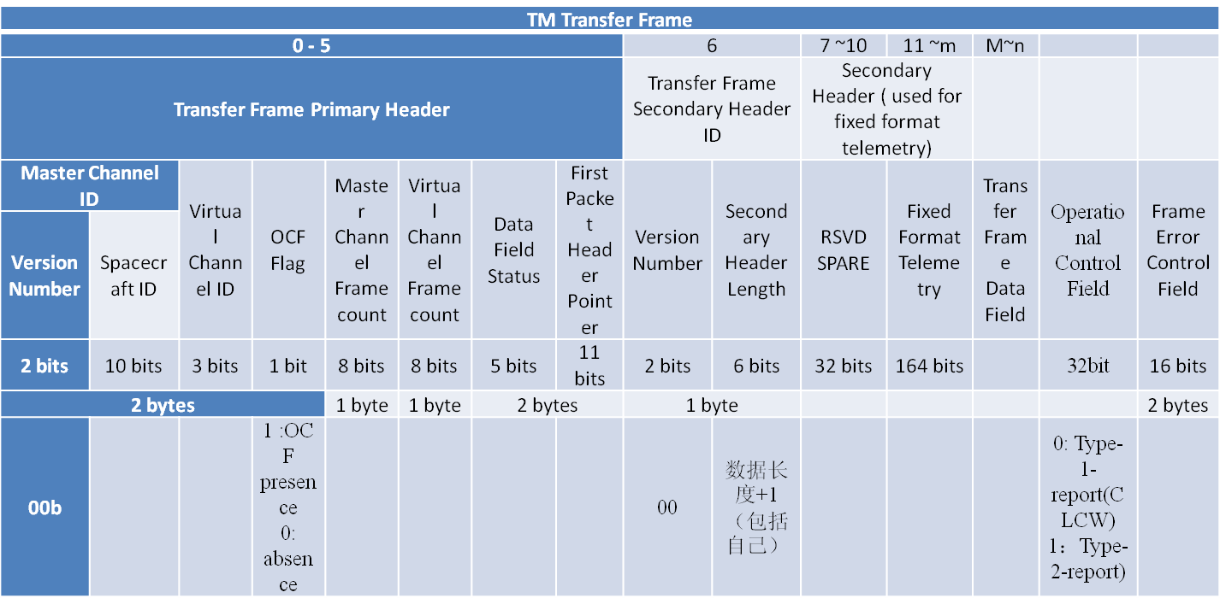
TM SPACE DATA LINK PROTOCOL

Slide 47
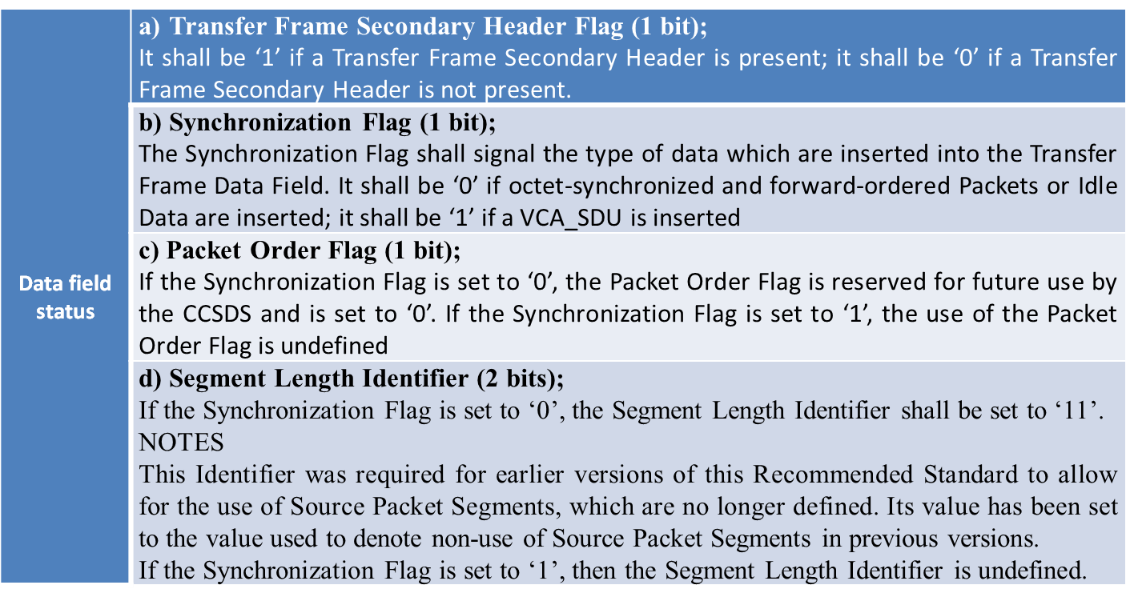
TM SPACE DATA LINK PROTOCOL

Slide 48
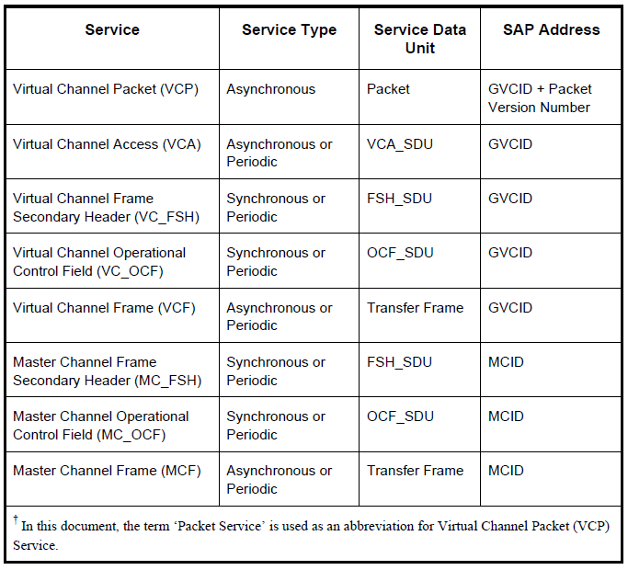
TM Space Data Link Protocol-Service

Slide 49
TM SPACE DATA LINK PROTOCOL
If no Packet starts in the Transfer Frame Data Field, the First Header Pointer shall be set to ‘11111111111’.
If a Transfer Frame contains only Idle Data in its Transfer Frame Data Field, the First Header Pointer shall be set to ‘11111111110’.
NOTE – A Transfer Frame with its First Header Pointer set to ‘11111111110’ is called an Only Idle Data (OID) Transfer Frame, meaning that it has Only Idle Data in its Data Field

Slide 50
PART 4: Telemetry Management
For the orbit of ETRSS-1, the GS can not always track and get the TM data of the satellite, thus delayed Telemetry is used to monitor the state of the satellite when it is not traced by GS.
The delayed telemetry is sampled from real-time telemetry by OBC， and stored in the memory of OBC, which will be transferred to GS when ETRSS-1 can be tracked. The sample ratio can be set through indirect TC from GS.

Slide 51
PART 4: Telemetry Management
N Second
real-time telemetry packet
real-time telemetry packet
N+1 Second
real-time telemetry packet
N+2 Second
real-time telemetry packet
N+3 Second
delayed telemetry packet
real-time telemetry packet
delayed telemetry packet
delayed telemetry

Slide 52
PART 4: Telemetry Management
Delayed Telemetry
Sampled ratio R_{a}: from 1 to 255
sampled
Real time TM packet
Delayed TM packet saved in OBC memory
sampled
TM packet collect period T_{s}
Delayed TM packet collect period T_{s}* R_{a}

Slide 53
PART 4: Telemetry Management
Summary
1. Telemetry is used for ground users to know the status and in orbit information of satellite.
2. Telemetry is divided into some packets, and different telemetry packets contain different equipment’s information.
There are two types of telemetry: real time telemetry and delayed time telemetry.

Slide 54
PART 5: Communication on-board
ETRSS-1 uses CAN Bus as the onboard network, all subsystems communicate with each other via CAN bus. OBC is the master node of the network, and other sub-computers are the slave nodes.

Slide 55
PART 5: Communication on-board

Slide 56
PART 5: Communication on-board
Introduction of CAN Bus
CAN Bus: Control Area Network Bus
Physical Layer Data link Layer Application Layer

Slide 57
PART 5: Communication on-board
CAN has the following properties
prioritization of messages
guarantee of latency times
configuration flexibility
multicast reception with time synchronization
system wide data consistency
multi master
error detection and signalling
automatic retransmission of corrupted messages as soon as the bus is idle again

Slide 58
PART 5: Communication on-board
Layered Architecture of CAN according to the OSI Reference Model
OSI (Open System Interconnect) Layers
CAN(Control Area Network) data bus Layers
Application Layer
Presentation Layer
Session Layer
Transport Layer
Network Layer
Data link Layer
Physical Layer
Data link Layer
Physical Layer

Slide 59
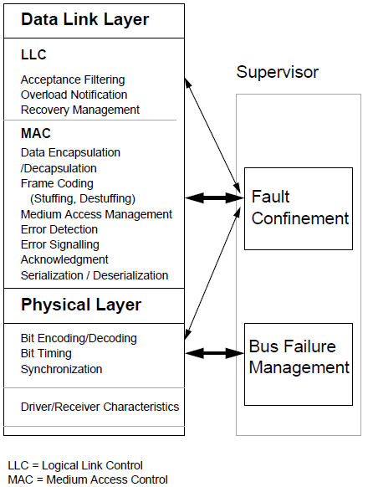
PART 5: Communication on-board
Embedded IP Core, SJA1000, etc…
Tja1040t,pca82c250, etc…

Slide 60
PART 5: Communication on-board
Each CAN node has micro CPU, CAN controller and driver, and has two CAN bus, bus A and bus B, and each bus has two cable, CAN-H and CAN-L, which are connected to the CAN-H and CAN-L cable of the whole CAN bus. 2 redundant CAN bus.

Slide 61
PART 5: Communication on-board
Physical Layer-Cable Connection
Each CAN node uses two bus sockets, one is for cable in and one is for cable out. The two sockets are connected in the node from pin to pin. The nodes are connected by twisted-pair cables. Terminal resistor is connected with the far end of the cables. the terminal resistance is 120Ω.

Slide 62
PART 5: Communication on-board
OBC sends TM collection frame to sub-computer, and sub-computer responds TM CAN frame one by one in the same bus. This procedure is called polling-responding.

Slide 63
PART 5: Communication on-board
OBC send TC frame to sub-computer, and sub-computer send respond frame to OBC at the same bus. This procedure is called selecting-responding. TC frame include indirect TC and data block.

Slide 64
PART 5: Communication on-board
Summary
1. CAN bus communication is the basis of information exchange. Functions including TC, TM, Time-tagged TC and time management need CAN bus communication.
3. Message is sent in the way of data frame. Master node is OBC and sub-computer is slave-node. OBC respectively polls sub-computers and collects TM.

Slide 65
PART 6: Time Management
There are two time references on board, one is platform time reference, and the other is GPS PPS time reference.
GPS PPS time reference is generated by GPS receiver and is used by payload, and which is more accurate than platform time reference.

Slide 66
PART 6: Time Management
Platform time reference is generated by OBC, which is used for time-tagged command, telemetry timestamp.
Payload uses platform time reference as degraded timing reference in case of GPS receiver is abnormal.

Slide 67
PART 6: Time Management
OBDH time management includes time generation, time broadcast and time calibration.
Time generation
Time
management
Time broadcast
Time calibration

Slide 68
PART 6: Time Management
Time generation:
OBDH time is provided by OBC. The time zero reference shall be 1st January 2009, 00 hour: 00minute: 00 second: 00millisecond (UTC). That means at that time the on-board time code is all zero.
Time broadcast:
OBC broadcasts OBDH time reference to other subsystems via platform CAN bus and payload CAN bus each second.

Slide 69
PART 6: Time Management
Time calibration
There are several ways to correct the on board time, such as GPS time self-calibration, GPS setting time (one time mode) and GS telecommand time calibration.
GS telcommand time calibration is used when GPS is abnormal, which includes one time adjustment (add or subtract) to the current on board time, uniform time correction and ground time setting.

Slide 70
PART 6: Time Management
GPS time self-calibration (default mode in orbit)
GPS
OBC
Collect/polling GPS UTC time periodically
Compare OBC time and GPS time, then calibrate OBC time.
GPS time

Slide 71
PART 6: Time Management
GPS setting time, used after launch or when OBC is reset .
GPS
OBC
Collect/polling GPS UTC time only one time
OBC using GPS time directly.
GPS time

Slide 72
PART 6: Time Management
One time adjustment (add or subtract) to the current on board time.
The time difference between the ground and satellite should be calculated by ground station and be transmitted through the uplink channel. OBC performs immediately the operation of addition between the on board time and the time difference in order to aim at the ground.

Slide 73
PART 6: Time Management
One time adjustment data block format.
NO | DATA | DESCRIPTION
0 | 40H | IDENTIFICATION
1 | 11H | ASSISTANT SYMBOL
2 | 01H | TYPE
3 | ##H | ADJUST SECOND Complementary code, HIGH BYTE FIRST
4 | ##H
5 | ##H
6 | ##H
7 | ##H | ADJUST MILLSECOND TRUE FORM, HIGH BYTE FIRST
8 | ##H

Slide 74
PART 6: Time Management
Uniform time correction .
The uniform time correction is to add or subtract periodically one millisecond of on board time to eliminate the predicted time error. The interval to perform the uniform time correction is the range from 1 to 0xFFFFFF seconds.

Slide 75
PART 6: Time Management
Uniform time correction Format.
NO | DATA | DESCRIPTION
0 | 40H | IDENTIFICATION
1 | 11H | ASSISTANT SYMBOL
2 | 02H | TYPE
3 | ##H | PERIOD TIME(Sec, >=1) TRUE FORM, HIGH BYTE FIRST
4 | ##H
5 | ##H
6 | ##H | PERIOD TIME(ms, <1000) TRUE FORM, HIGH BYTE FIRST
7 | ##H
8 | ##H | 00H: STOP; 66H: +1ms 99H: -1ms

Slide 76
PART 6: Time Management
Ground time setting .
Ground time setting means setting the on board time directly according to forward data block .
NO | DATA | DESCRIPTION
0 | 40H | IDENTIFICATION
1 | 11H | ASSISTANT SYMBOL
2 | 03H | TYPE
3 | ##H | ADJUST SECOND TRUE FORM, HIGH BYTE FIRST
4 | ##H
5 | ##H
6 | ##H
7 | ##H | ADJUST MILLSECOND TRUE FORM, HIGH BYTE FIRST
8 | ##H

Slide 77
PART 6: Time Management
Summary
a. In orbit，OBC will adjust its time with GPS automatically, generally it is not necessary to correct OBC time by ground;
b. When GPS falls in failure, and the difference between OBC time and ground time is greater than 5ms, it needs time correction;

Slide 78
PART 6: Time Management
Summary
c. When OBC switch or reset in orbit , it needs ground to set time and correct time;
d. When the leap second occurs, OBC will adjust 1ms every 8s with GPS automatically, so OBC time will synchronize with GPS time automatically after 4000s without ground intervention.

Slide 79
PART 7: Time-tagged Command
When the satellite is out of track, the TC from ground will not work. ETRSS-1 uses time-tagged TC(TTC), time-tagged data(TTD) and Relative time-tagged TC(RTTC) to let the satellite work in the predefined sequence. In orbit, the payload task is mainly made up of TTC, TTD and RTTC.
GS sends TTC block to satellite when it can be tracked, and then the TTC block is stored in OBC SRAM.

Slide 80
PART 7: Time-tagged Command
Each TTC is composed with 8 bytes. The first 4 bytes is UTC time to be executed, and the last 4 bytes is execution code (Indirect TC CODE).
Compare TTC time to Onboard time
Ground Station
OBC
Subcomputer
Batch of TTCs
Saved in OBC SRAM
When time reach, OBC will execute the command or send it to subcomputer and then clear it from SRAM.

Slide 81
PART 7: Time-tagged Command
TTC data block format.
NO | DATA | DESCRIPTION
0 | 80H | IDENTIFICATION
1 | m | LENGTH
2 | 00H | RESERVE WORD
3 | n | COMMAND COUNT
4 | ##H | UTC TIME1
5 | ##H
6 | ##H
7 | ##H
 | ##H | EXECUTION CODE1
 | ##H
 | ##H
 | ##H
 | ##H | UTC TIME2
 | ##H
 | ##H
 | ##H
 | ##H | EXECUTION CODE2
 | ##H
 | ##H
 | ##H
 |  | …
 |  | …
 | ##H
 | ##H | UTC TIMEn
 | ##H
 | ##H
 | ##H
 | ##H | EXECUTION CODEn
 | ##H
m+1 | ##H
m+2 | ##H
 | AAH | RESERVED
 | …
 | AAH
L-1 | AAH

Slide 82
PART 7: Time-tagged Command
TTC data block insert rule.
No | New TTC Data block |  | TTC in buffer | Executing status
1 | Max time | < | Min time | New TTC block insert in front of Min time command
2 | Min time | > | Max time | New TTC block insert in behind of Max time command
3 | Min time | > | Command n time | New TTC block insert between command n and command n+1
 | Max time | < | Command n+1 time
4 | Other condition |  |  | TTC error

Slide 83
PART 8: Time-tagged data block
Time-tagged data block.
TTD is extension of TTC. Each TTD is composed with 38 bytes. The first 4 bytes is UTC time, the next is virtual channel ID and Task ID, and the last 32bytes is TC data. (For TTC is 4 bytes indirect TC)
Compare TTD time to Onboard time
Ground Station
OBC
Subcomputer
Batch of TTDs
Saved in OBC SRAM

Slide 84
PART 8: Time-tagged data block
GS sends TTD block to satellite when it can be tracked, and then the TTD block is stored in OBC SRAM.
When time reach, OBC will send it to sub-computer and then clear it from SRAM.

Slide 85
PART 8: Time-tagged data block
TTD data block format.
 |  | …
 | ##H
 | ##H | Data block time n (s)
 | ##H
 | ##H
 | ##H
 | ##H | Data block channel identification n
 | ##H | Data block code n
 | ##H
 | ##H
 | ##H
 | ##H
 | ##H
 | …
m | ##H
m+1 | ##H
 | AAH | reserved
 | …
 | AAH
L-1 | AAH
NO | DATA | DESCRIPTION
0 | C0H | IDENTIFICATION
1 | m | Length m=38n+2
2 | 00H | reserved
3 | n | Command counter
4 | ##H | Data block time 1 (s)
5 | ##H
6 | ##H
7 | ##H
8 | ##H | Data block channel identification 1
9 | ##H | Data block Task ID
10 | ##H | Data block code 1
11 | ##H
12 | ##H
13 | ##H
14 | ##H
… | …
40 | ##H
41 | ##H

Slide 86
PART 8: Time-tagged data block
TTD data block insert rule.
No | New TTD Data block |  | TTD in buffer | Executing status
1 | Max time | < | Min time | New TTD block insert in front of Min time command
2 | Min time | > | Max time | New TTD block insert in behind of Max time command
3 | Min time | > | Command n time | New TTD block insert between command n and command n+1
 | Max time | < | Command n+1 time
4 | Other condition |  |  | TTD error

Slide 87
PART 9: Relative time-tagged telecommand
For the TC sequence used to power on and power off payload devices is always the same in a work mode, ETRSS-1 uses RTTC to store the TC sequences of woks modes usually used in orbit.
There are 32 groups of RTTC in ETRSS-1, each group can store no more than 38 TCs.
RTTC can be start by a TTC, and will not be cleared when executed, which will greatly reduce the TTC blocks to be sent by GS.

Slide 88
PART 9: Relative time-tagged telecommand
Relative time-tagged telecommand.
Each RTTC is composed with 6 bytes. The first 2 bytes is the time relative to start time, and the last 4 bytes is TC code (Indirect TC CODE).
Compare RTTC time with relative counter to start time
Ground Station
OBC
Subcomputer
A group RTTTC
Saved in OBC EEPROM

Slide 89
PART 9: Relative time-tagged telecommand
TTTC and RTTTC comparison
NO | TTC | RTTC
1 | Be clear after execution | Not clear after execution
2 | Support 1000 TTC saved in OBC at most. | Max 32 groups, and each group can store 38 TCs
3 | Compared to absolute UTC time | Compared to relative the time of start RTTC group
4 | Cooperated with RTTC used for mission operation | General used fixed command sequence ,like payload power on /power off sequence

Slide 90
PART 9: Relative time-tagged telecommand
Each group of RTTCs can be divided into 2 segments with ID 1 and 2. Generally segments 1 used for payload power on and segments 2 used for power off. And the time between segments 1 and segments 2 can be controlled by the TC of start RTTTC.
Segment 1
Segment 1
Segment 1
△t
Segment 2
Segment 2
Segment 2

Slide 91
PART 9: Relative time-tagged telecommand
RTTC data block format.
NO | DATA | LENGTH | DESCRIPTION
0 | A0H | 1 | IDENTIFICATION
1 | ##H | 1 | group number
2 | ##H | 1 | Command counter
3 | ##H | 8 | reserved
4 | ##H | 2 | High 4bit, segment id Low 12bit, TC ∆time
 | ##H | 4 | TC code 1
 | ##H | 2 | High 4bit, segment id Low 12bit, TC ∆time
 | ##H | 4 | TC code 2
… | … | … | …
 | ##H | 2 | High 4bit, segment id Low 12bit, TC ∆time
L-1 | ##H | 4 | TC code n

Slide 92
PART 10: Safe Mode
OBDH subsystem monitors the required parameters and manages the safe mode of the satellite. OBDH is mainly responsible for system level FDIR to make sure the safety of satellite system.
The TMs monitored by OBDH directly or indirectly include battery voltage, battery temperature, the mode of AOCS, status of BAPTA and the communication status of some units.

Slide 93
PART 10: Safe Mode
OBDH monitors the critical TMs (such as the status of power supply system and AOCS). When the critical TMs become abnormal, OBDH sends safe command sequence, such as turning off the payload, making sure the satellite energy is preserved safely.

Slide 94
PART 11: Thermal Control
OBDH provides 32Channels of temperature and analog data measure and 24 Channels of heaters.
Active thermal control is used in TCU software. The heaters are activated or de-activated by the software based on a threshold temperatures. The threshold values can be modified by ground telecommand.

Slide 95
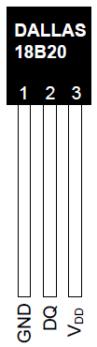
PART 11: Thermal Control
1-Wire Thermal Resister
Thermal Resister
heater

Slide 96
PART 11: Thermal Control
Open-Loop
Indirect TC uploaded from ground control heater to on or off.
Closed-Loop
If the temperature is below temperature for opening the heater, then the heater is switched on. If the temperature is upper temperature for closing the heater, then the heater is switched off.

Slide 97
PART 11: Thermal Control
Open-Loop
Output is controlled by input, input is controlled by the GS.

Slide 98
PART 11: Thermal Control
Closed-Loop
TCU collects thermal resister as the feedback of temperature control loop

Slide 99
OBDH Summary
OBDH is responsible for onboard data management. Its functions are to distribute telecommand received from ground to all subsystems, collect telemetry from all subsystems, platform on-board timing reference generation and distribution，thermal control, AOCS important data storage, It transmits command and data, collects telemetry and distributes mission management via CAN bus.
OBDH subsystem includes onboard computer (OBC) and thermal control unit (TCU).

Slide 100
Content Summary
OBDH Specification
OBDH Composition
Telecommand Management
Telemetry Management
Communication on-board
Time Management
Time-tagged Command
Time-tagged data block
Relative time-tagged telecommand
Safe Mode
Thermal Control

Slide 101
THANKs FOR Your ATTENTION
Q & A?

